Slide 1


Detection & Instance Segmentation of Foot Ulcer

Slide 3

CONTENTS
1. Team Members
2. Agenda
3. Introduction
4. Problem Statement
5. Objectives
6. Project Significance
7. Literature Survey
8. Project Workflow
9. Dataset Creation
10. Dataset Statistics
11. Dataset Processing
12. Dataset Challenges
13. Model Selection: YOLOv8
14. Model Selection: YOLOv11
15. Training Process
16. Evaluation Metrics
17. Performance Graphs
18. Performance Comparison
19. Key Performance Results
20. Instance Segmentation Results
21. Object Detection Results
22. Error Analysis
23. Key Findings
24. Clinical Applications
25. Future Improvements
26. Potential Applications
27. Conclusion

Slide 4

1. Team Members
SOURAV PRASAD (22052601)
ARYAN RAJ (22052973)
KSHITIJ KR. GUPTA (22052992)

Slide 5








2. Agenda
Introduction
Problem Statement & Objectives
Dataset Details
Methodology
Implementation
Results & Analysis
Conclusion & Future Scope

Slide 6





3. Introduction
Foot ulcers require early and accurate detection to avoid complications
Manual examinations are subjective and time-consuming
Instance segmentation allows differentiation between multiple ulcers in a single image
Automated solutions can enhance diagnostic accuracy and efficiency

Slide 7

4. Problem Statement
1
Need for efficient, automated foot ulcer detection and segmentation
2
Challenge of distinguishing between multiple ulcers in a single image
3
Requirement for real-time processing capabilities

Slide 8




5. Objectives
Develop a model for accurate foot ulcer detection and instance segmentation
Compare performance of YOLOv8 and YOLOv11 models
Create a system to assist healthcare professionals in early diagnosis
Enable monitoring of ulcer progression through precise segmentation

Slide 9

6. Project Significance
1
Early detection prevents severe complications
2
Automated system reduces burden on medical practitioners
3
Precise segmentation aids in treatment planning
4
Monitoring capabilities help track healing progress
5
Potential integration into telemedicine applications

Slide 10







7. Literature Survey
Traditional object detection: R-CNN, Fast R-CNN, Faster R-CNN, SSD
YOLO family evolution:
YOLOv8: Anchor-free detection, improved backbone network
YOLOv11: Attention mechanisms, transformer-based architecture
Challenges: Small object detection, generalization, computational efficiency

Slide 11
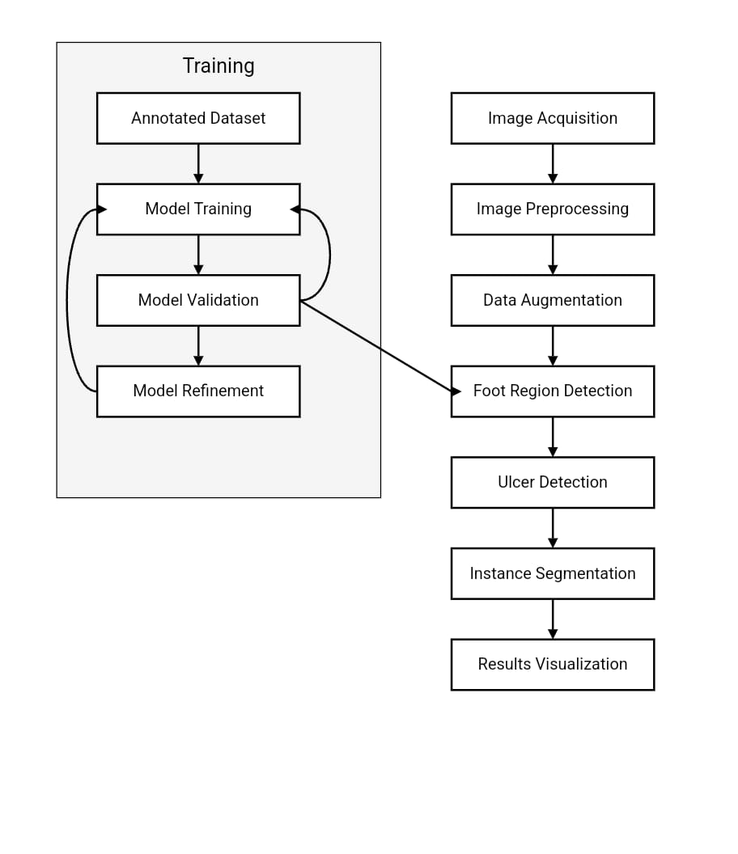
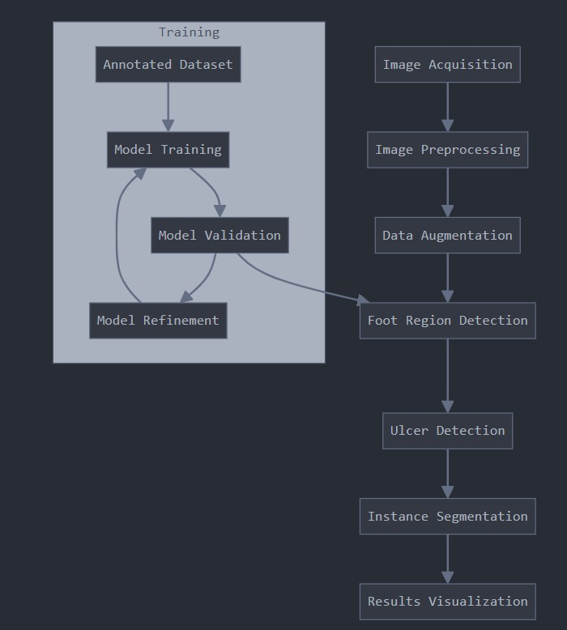
8. Project Workflow

Slide 12
9. Dataset Creation
1
Created using Roboflow platform
2
Sources: Medical datasets and clinical records
3
Diverse ulcer stages, sizes, and variations
4
Ethical considerations and data protection compliance

Slide 13





10. Dataset Statistics
Total Images: 832
Training Set: 582 images (70%)
Validation Set: 166 images (20%)
Testing Set: 84 images (10%)
Annotations: Bounding boxes and segmentation masks

Slide 14

11. Dataset Preprocessing
Resizing to 640x640 pixels
Normalization
Data augmentation:
Flipping (horizontal/vertical)
Contrast enhancement
Rotation
Scaling

Slide 15

12. Dataset Challenges
High variability in ulcer appearances (color, texture, severity)
Class imbalance between ulcer categories
Labor-intensive annotation process for segmentation masks
Lighting variations requiring adaptive preprocessing

Slide 16
13. Key Features: YOLOv8
1
Anchor-free design for better small object detection
2
CSPDarkNet backbone for optimized feature extraction
3
Enhanced post-processing techniques
4
Multi-task capabilities (detection, segmentation, classification)

Slide 17


14. Key Features:YOLOv11
Hybrid Transformer-CNN backbone
Self-attention and spatial attention mechanisms
Sparse convolution and dynamic quantization
Higher speed and accuracy than YOLOv8
Optimized for edge devices

Slide 18
15. Training Process
Batch Size: 16
Epochs: 50
Loss Functions:
CIoU loss (for bounding boxes)
Dice loss (for segmentation masks)
Data augmentation applied during training
Early stopping to prevent overfitting

Slide 19





16. Evaluation Metrics
Precision (P): TP/(TP+FP) - Correctly detected ulcers among all detections
Recall (R): TP/(TP+FN) - Detection rate of all ulcer instances
mAP50: Average precision at IoU threshold = 0.5
mAP50-95: Mean AP across multiple IoU thresholds (0.50 to 0.95)
Inference Speed: Time taken per image during prediction

Slide 20
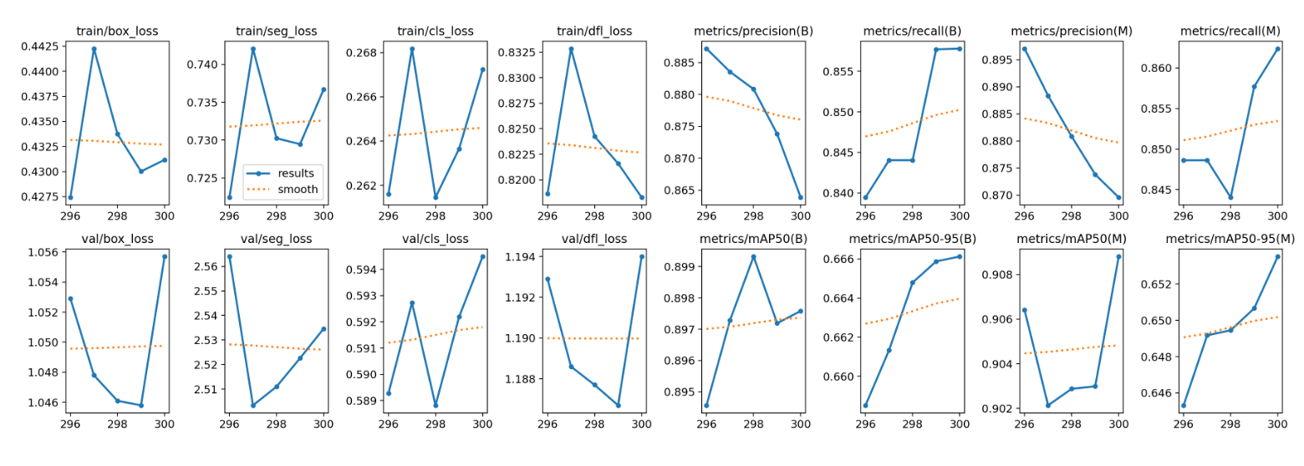
17. Performance Graphs

Slide 21
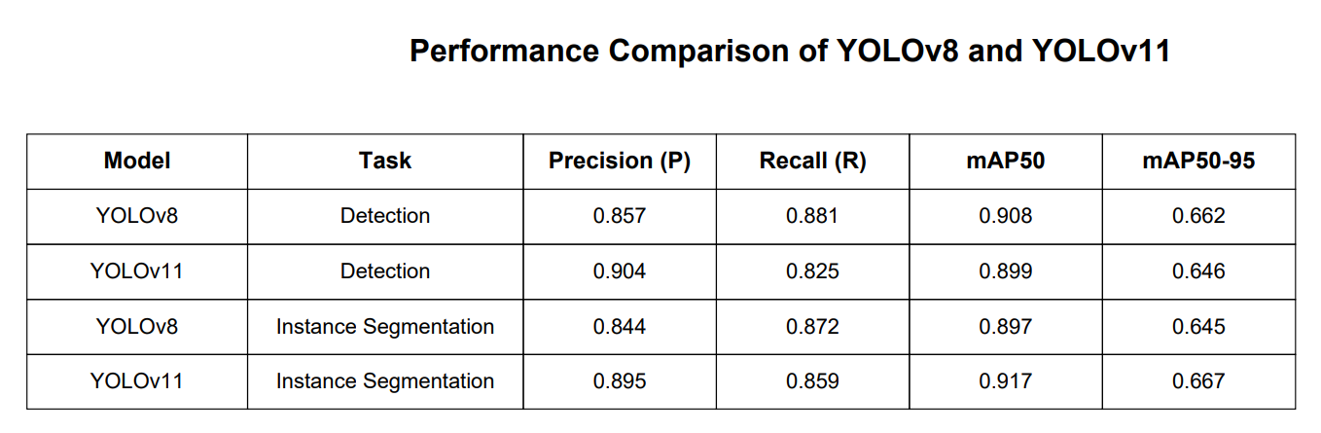
18. Performance Comparison

Slide 22


19. Key Performance Results
YOLOv11 outperforms YOLOv8 in most metrics
Instance segmentation with YOLOv11 shows 2% increase in mAP50
YOLOv11 achieves highest precision (0.904) for detection
YOLOv8 remains competitive and delivers reliable results

Slide 23
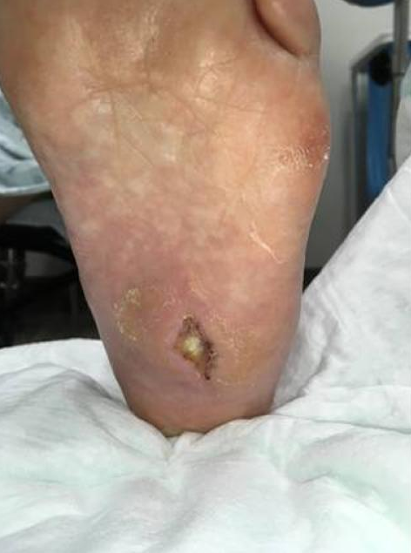
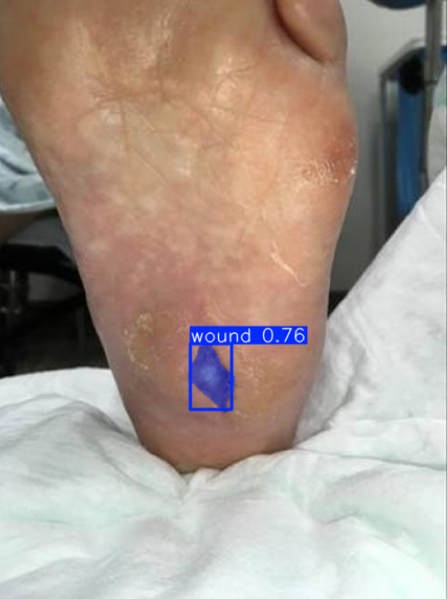
20. Instance Segmentation Results

Slide 24
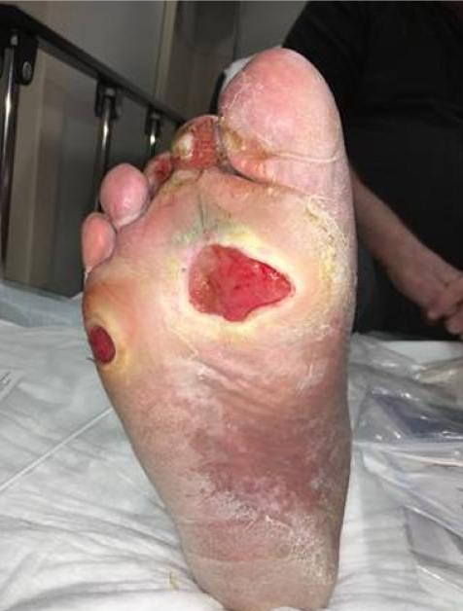
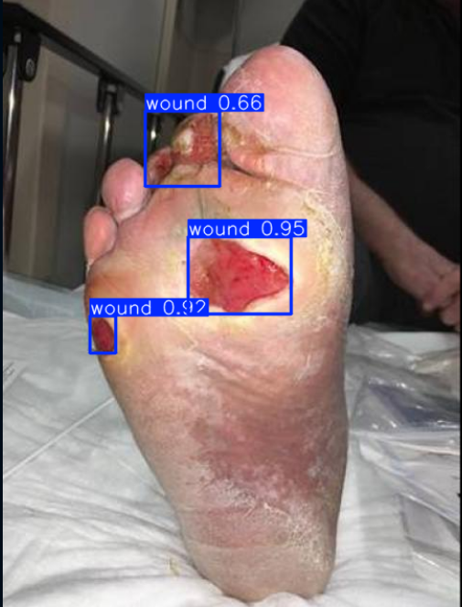
21. Object Detection Results

Slide 25


22. Error Analysis
False Positives: Areas incorrectly identified as ulcers
False Negatives: Small ulcer regions missed by models
Overlap Issues: Improper instance mask overlapping
Class Confusion: Misclassifications between small ulcers and background textures

Slide 26

23. Key Findings
YOLOv11 demonstrates improved accuracy over YOLOv8
Enhanced small object detection with hybrid architecture
Faster inference times suitable for clinical applications
Robust training with better class imbalance handling
Optimized for deployment on edge devices

Slide 27
24. Clinical Applications
Assist healthcare professionals in early diagnosis
Treatment planning based on accurate segmentation
Monitoring ulcer progression over time
Integration with telemedicine platforms
Patient education and self-monitoring tools

Slide 28


25. Future Improvements
Further model optimization to reduce computational complexity
Integration of self-supervised learning to reduce labeled data requirements
Multi-modal approaches combining visual data with other sensors
Domain adaptation for better generalization across diverse datasets
Extension to 3D object detection for volumetric analysis

Slide 29

26. Potential Applications
1
Healthcare and medical imaging
2
Telemedicine and remote monitoring
3
Research and clinical trials
4
Home-based monitoring for diabetic patients
5
Mobile applications for preliminary screening

Slide 30
27. Conclusion:
The transition from YOLOv8 to YOLOv11 has led to notable advancements in accuracy, efficiency, and real-time adaptability. YOLOv11’s improvements in feature extraction,
computational optimization, and small object detection make it a highly versatile state-of-the-art model. As the field of computer vision advances, further optimizations and integrations with emerging AI technologies will enhance YOLO’s capabilities, expanding its applications across industries.

